Slide 1

Slide 1
The Best-fit Position Analysis
IBM Applied Data Science Capstone
Jie Wu

Slide 2
Slide 9
PROJECT TIMELINE
PROBLEM FINDING
DATA WRANGLING
Manhattan food delivery start-ups need to find best-fit locations to provide the fastest service
Use Google Geocode API to do the transformation between the address and coordinate in order to prepare the onehot dataset
FINAL RESULT
DATA COLLECTING
CLUSTERING ANALYSIS
Use Foursquare API to collect Manhattan top-rated food stores data
Use K-means clustering algorithm to segment the food stores and find the centers of the those clusters
1

Slide 3
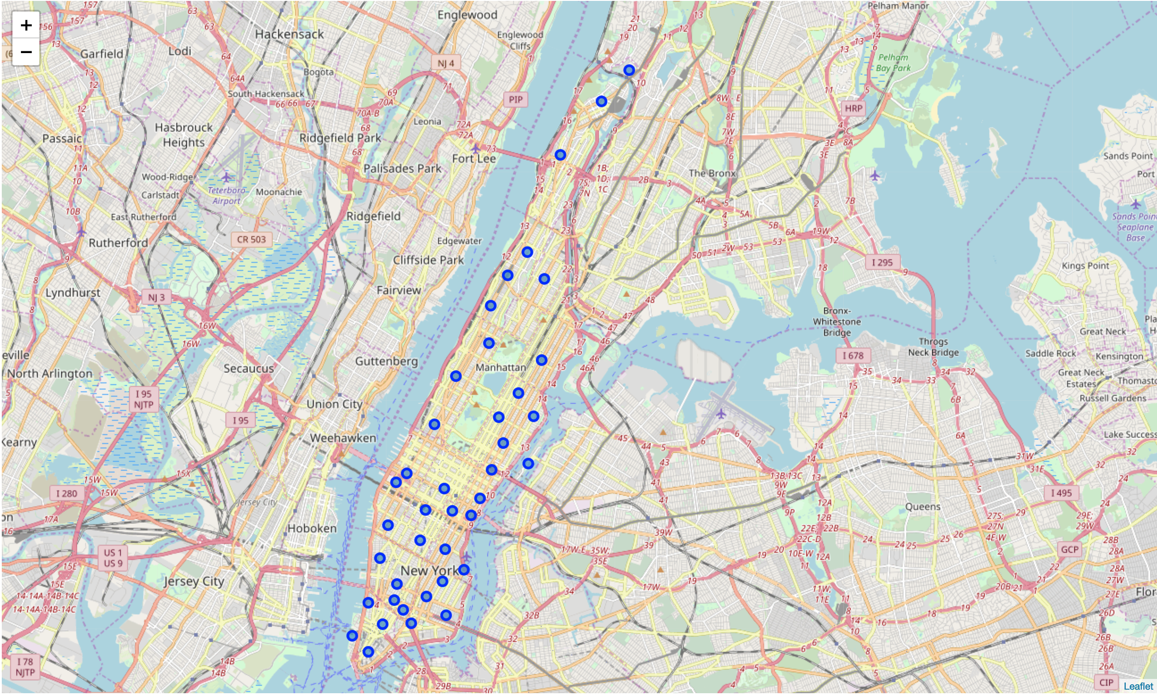
Slide 2
NEIGHBORHOOD CANDIDATES
The 40 neighborhood candidates in Manhattan. We will use Foursquare API to collect the food stores dataset in the 40 candidates.
2

Slide 4
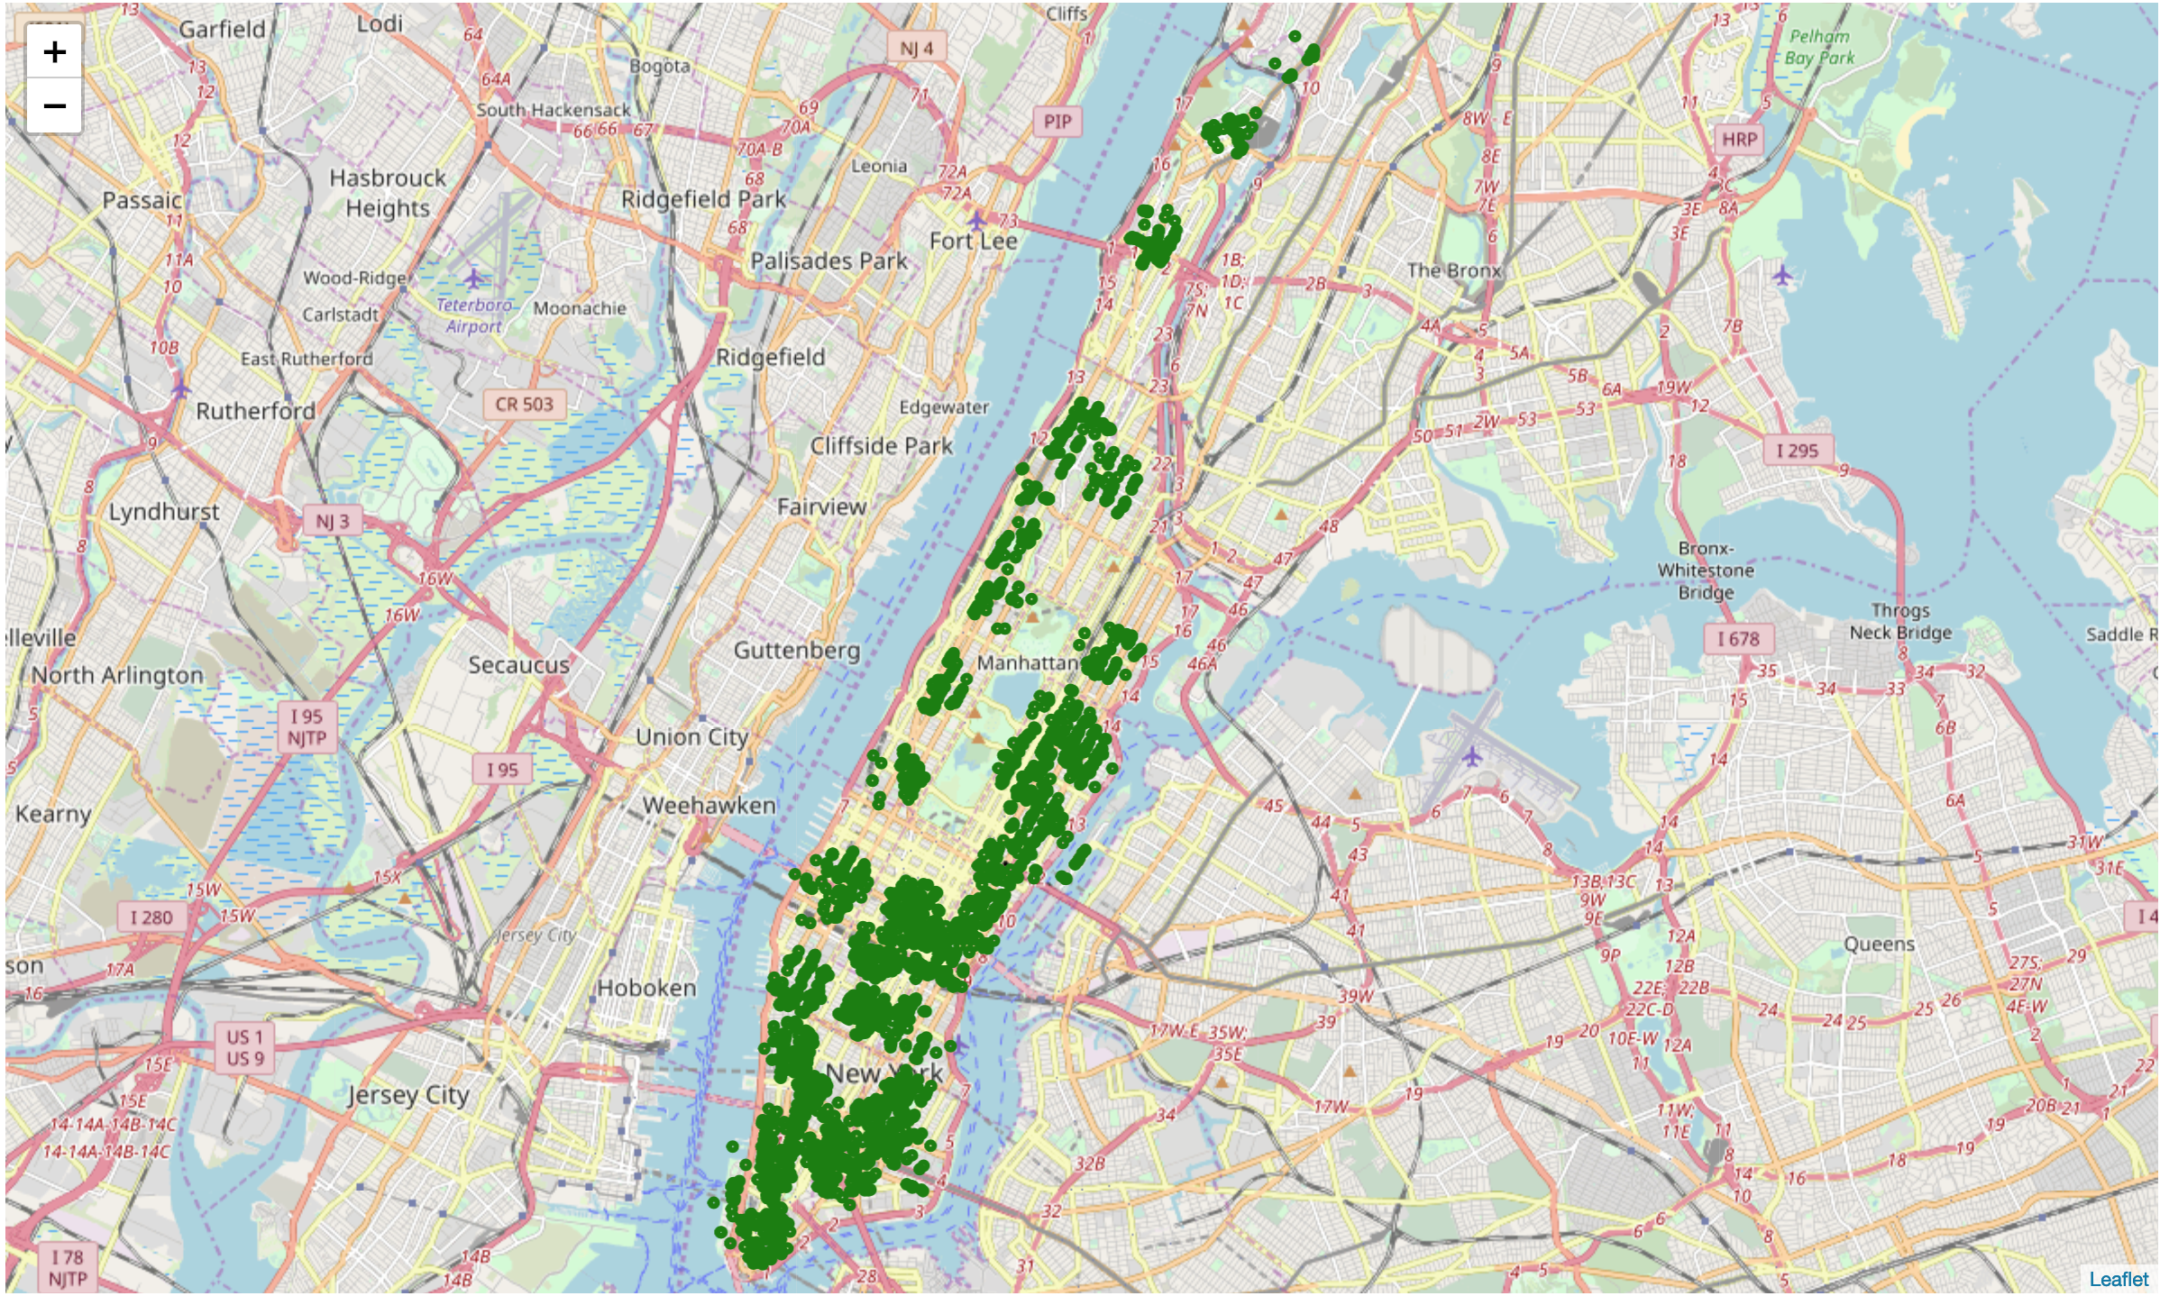
Slide 2
TOP-RATED FOOD STORES
More than 2800 top-rated food stores in Manhattan area
3

Slide 5
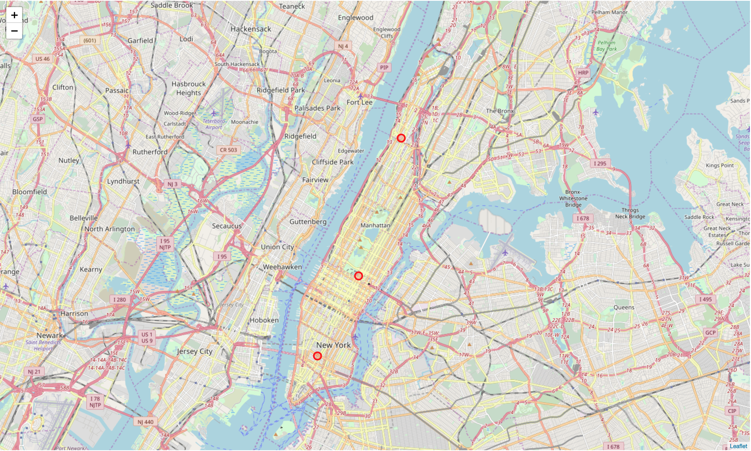
Slide 8
FINAL RESULT
1833 Amsterdam Ave, New York, NY 10031
59th & Madison, New York, NY 10022
166 Mercer St, New York, NY 10012
5

Slide 6

Slide 11
THANK YOU

